Slide 1


BBA
Hospitality and Facilities Management
A way forward to a bright career in the field of services

Slide 2
About the course
It is the first time ever that a Bachelor course is being offered by Savitribai Phule Pune University
Bachelor of Business Administration course is a 3 – year , Full time, under-graduate program
No other course provides distinctive combination of Business Administration with a focus on Hospitality & Facilities Management.

Slide 3
Eligibility
HSC(12TH ) Pass - Arts/Science/Commerce/Vocational
English as one of the languages in Hsc.
Minimum Aggregate marks: 45%
Minimum for Reserved Category: 40%

Slide 4
Structure
Six semesters spread over 3 years.
31 courses offered including project studies.
20 weeks of Industrial Training with stipend in 4th semester.

Slide 5
Admission
Website:- www.pumba.in
Contact:- Dr.Deepa Prasad - 9822752725
Prof. Arati Prabhu - 9765511218
Email Id:- pumba.bbahfm@gmail.com
Find more about us on :-
Facebook – PUMBA BBA HFM
Instagram – pumba_bba_hfm

Slide 6
Qualifies the student for:
We profile multitude of industries from which students can envision and decide for to a chosen path in the field of services.
Retail Management
Event Management
Facilities Management
Hospitality Management
Travel & Tourism
Banking & Finance
Customer Relationship and Care
Sales and Marketing
Administration Management

Slide 7

Sectors
Banking, Finance, IT, Operations & Sales, etc.

Slide 8

Facilities Sector
Retail/Mall management, Event management, Hotel management, Tourism, etc.

Slide 9
Campus katta
The campus also provides accommodation for students
Newly designed building comprising of :-
Computer lab
Classrooms
Library
Auditorium
Canteen

Slide 10
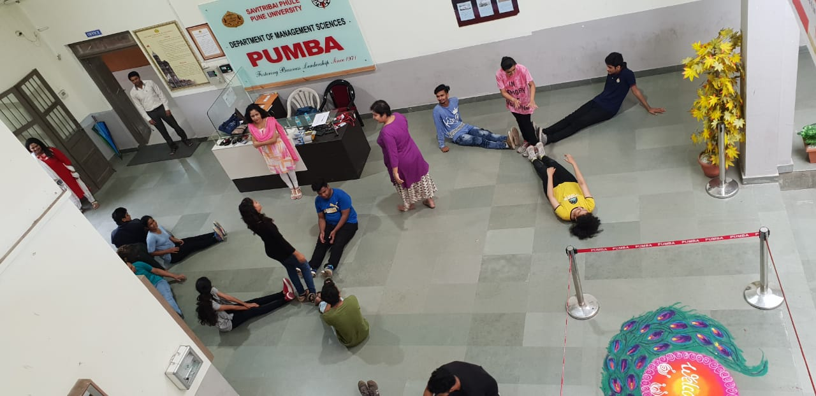
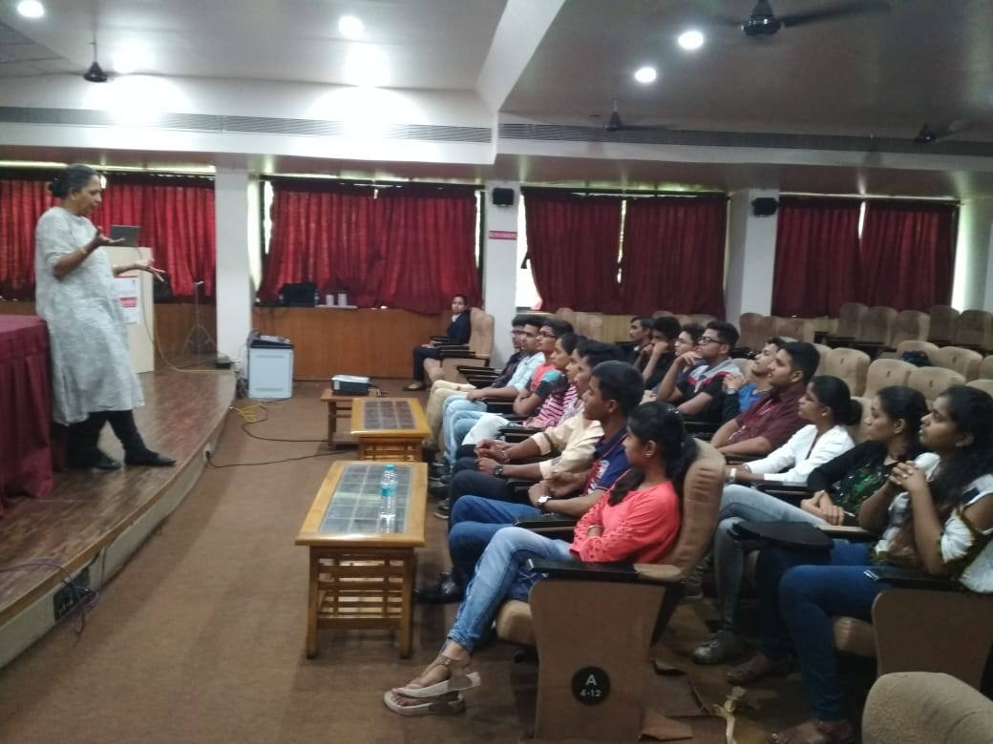
Induction program
Students getting to know each other.
Well known persons from the industry interacting with the new
batch

Slide 11
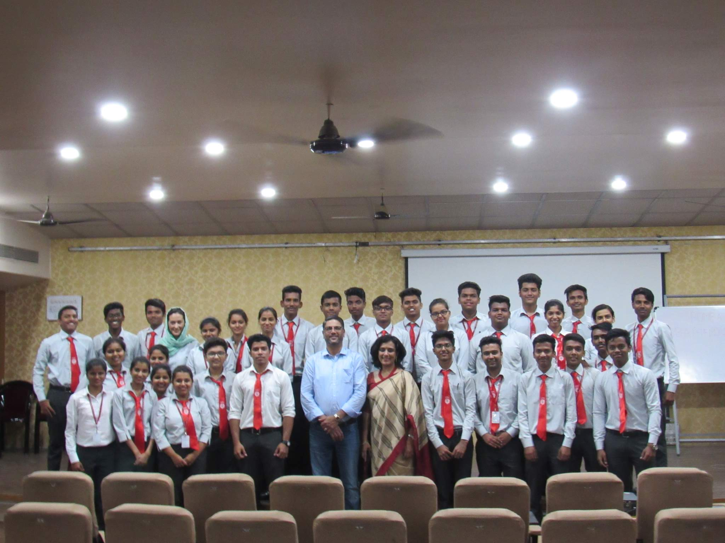
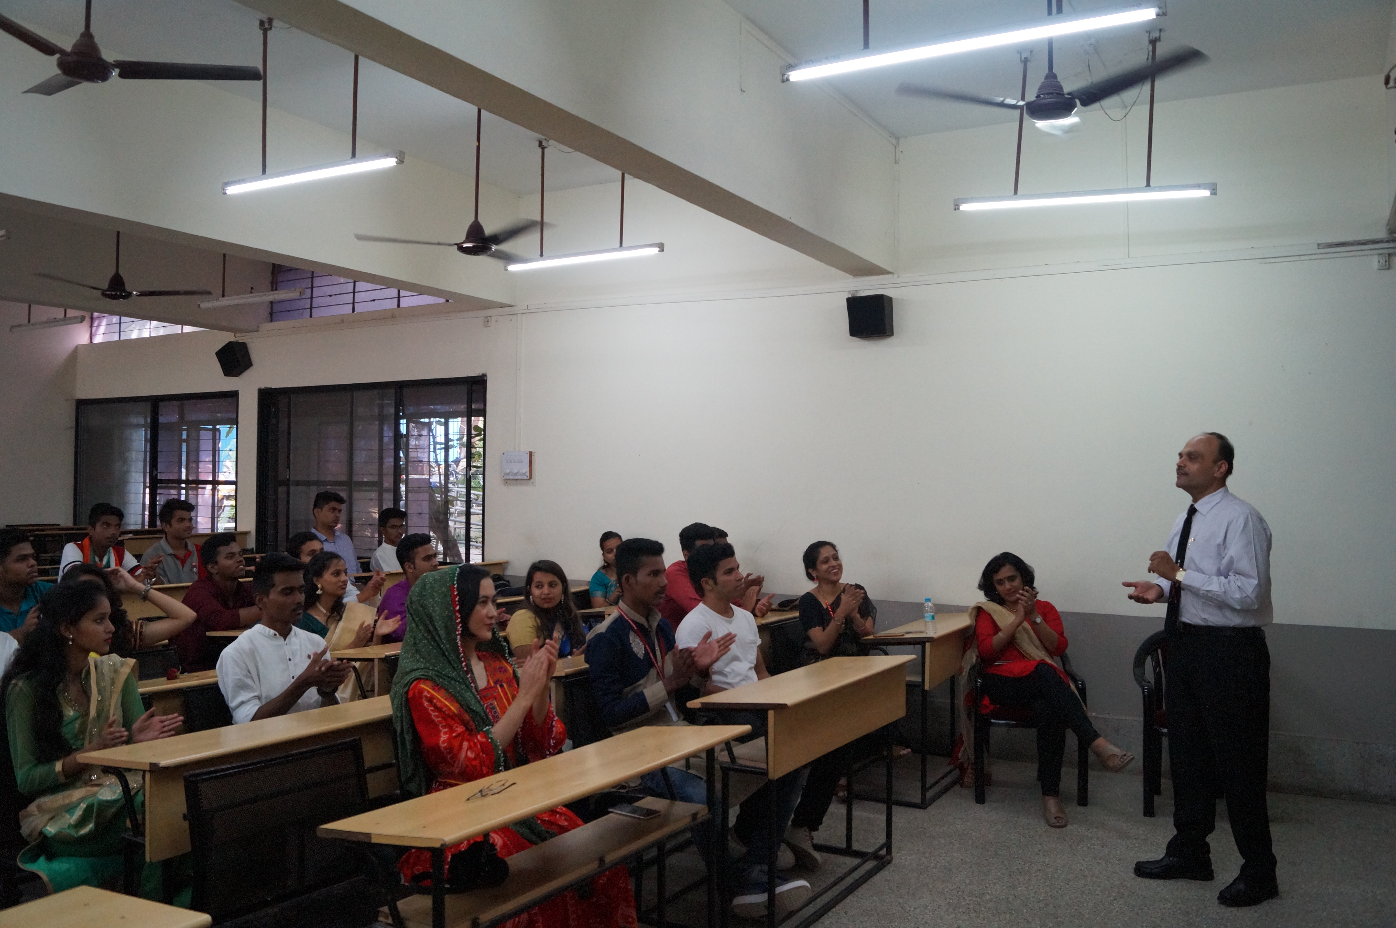
Students Corner
Guest lecture
World Tourism day

Slide 12
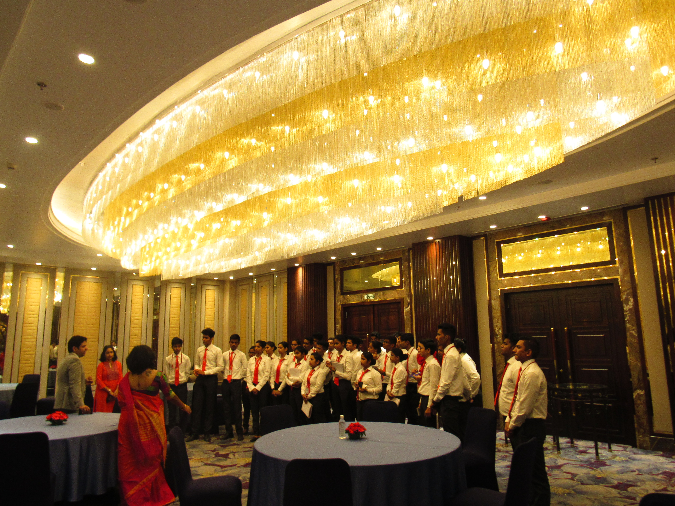
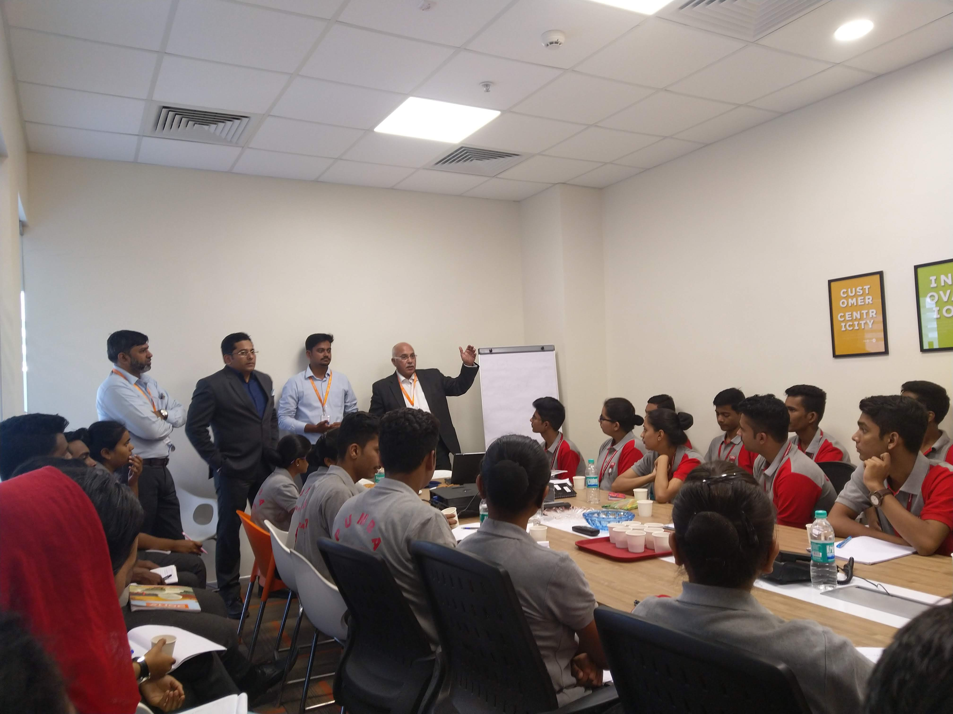
Industrial Visits
Sheraton Grand
Westend Mall

Slide 13

Preparing professionals for future market demands

